Slide 1






LEARNING MANAGEMENT SYSTEM
Created by:
Milko Dimoski 213229
Darko Dimitrov 213089

Slide 2

INTRODUCTION
Our innovative Learning Management System (LMS) is designed to provide an easy-to-use, comprehensive platform for students, teachers, and administrators.
This system streamlines the learning experience by offering tools for course management, lesson delivery, and student enrollment, all in one place.

Slide 3
Key Features:
Seamless course and lesson creation for teachers
User-friendly dashboards for students,teachers and admins
Efficient student enrollment and course tracking
Multimedia support for rich content delivery

Slide 4
COURSES PAGE
02
01
03
HOME PAGE
LOGIN PAGE
04
LESSONS PAGE

Slide 5
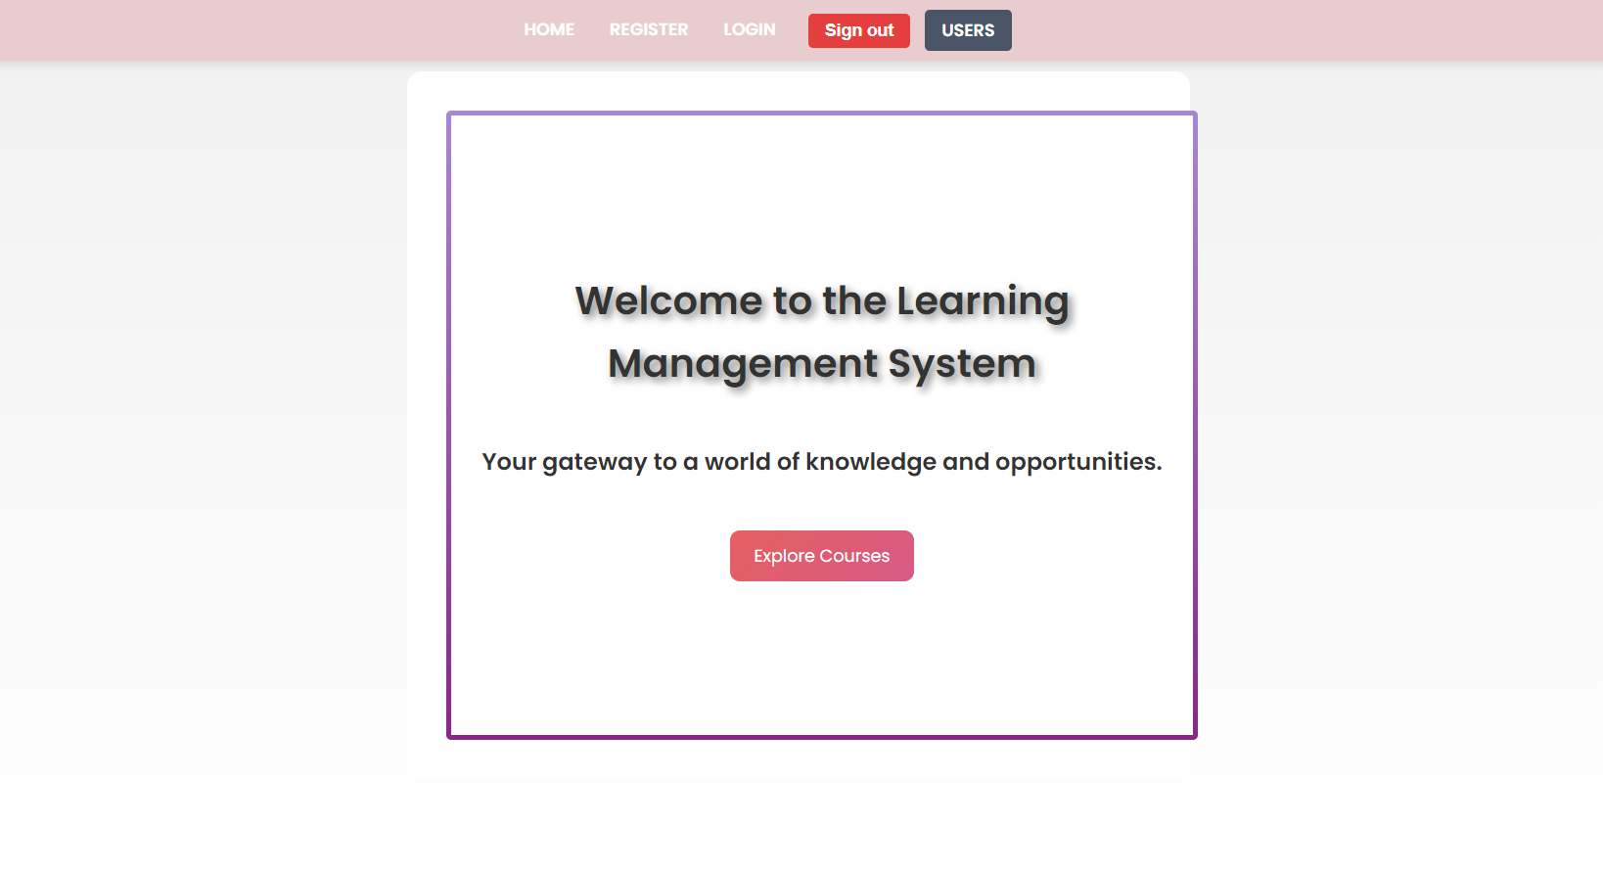

HOME PAGE
LMS Homepage Overview
The homepage serves as a central hub, providing easy navigation and quick access to key features for students, teachers, and administrators.
Students can view their enrolled courses, access lessons, and track progress.
Teachers can manage courses, upload content, and interact with students.
Admins can oversee the entire platform, adding courses and managing users.
With a clean and intuitive design, the homepage enhances user experience and ensures a smooth learning process for everyone.

Slide 6
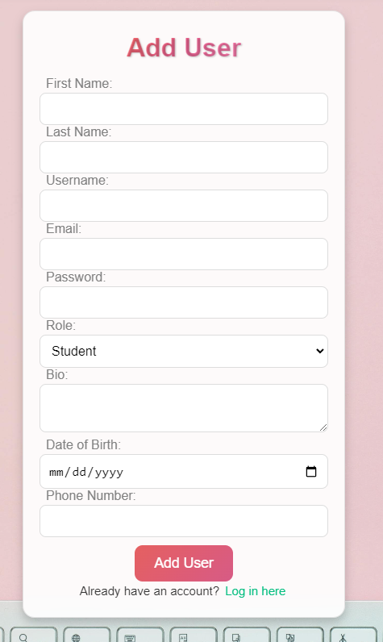
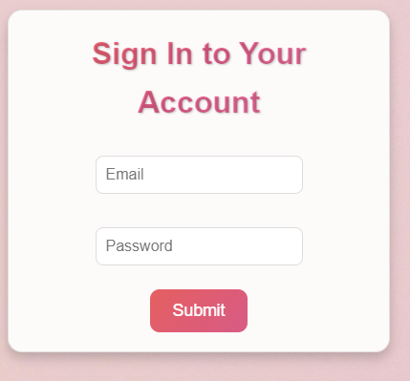

SignUp/Login Page
Login page are the main pages on our app. To login or sign up, we are using the firebase extension as base where we can save our accounts.
Once signed up, the page will remotely go to the login site.

Slide 7
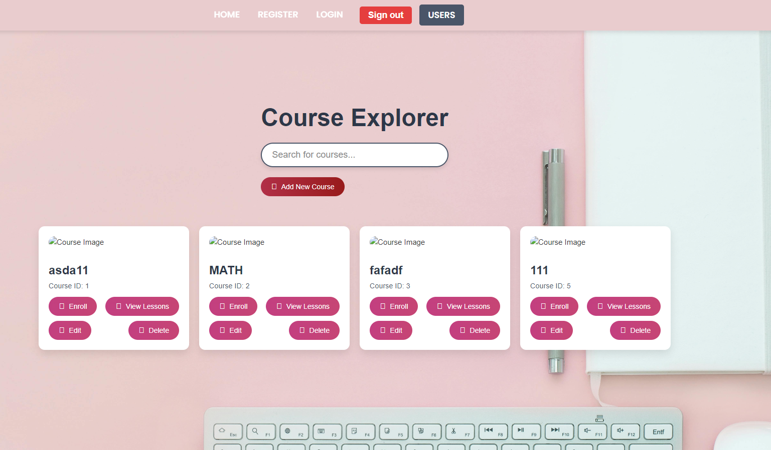
Courses Page
The Course List page provides students with a view of all available courses, organized by categories or subjects. Each course includes key details such as the title, description, and instructor, along with the option to enroll.
The Search Panel allows users to easily filter and find specific courses based on criteria like course name, category, or instructor. This feature ensures quick access to relevant content, making it easier for students to explore and enroll in the courses that match their interests.

Slide 8
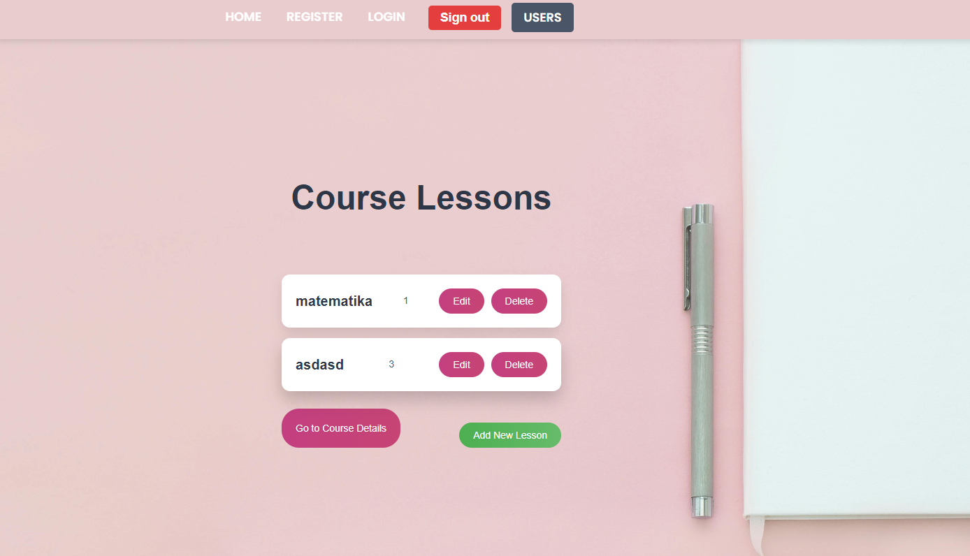
Lessons Page
The Lessons Page provides an overview of all lessons within a course, displayed in an organized list. Teachers can easily manage course content through the Add Lesson feature, which allows them to upload new lesson materials, including videos and text.
Additionally, the Delete function enables teachers to remove outdated or irrelevant lessons from the course, ensuring that students have access to the most up-to-date learning resources.

Slide 9
Thanks for watching

